Slide 1
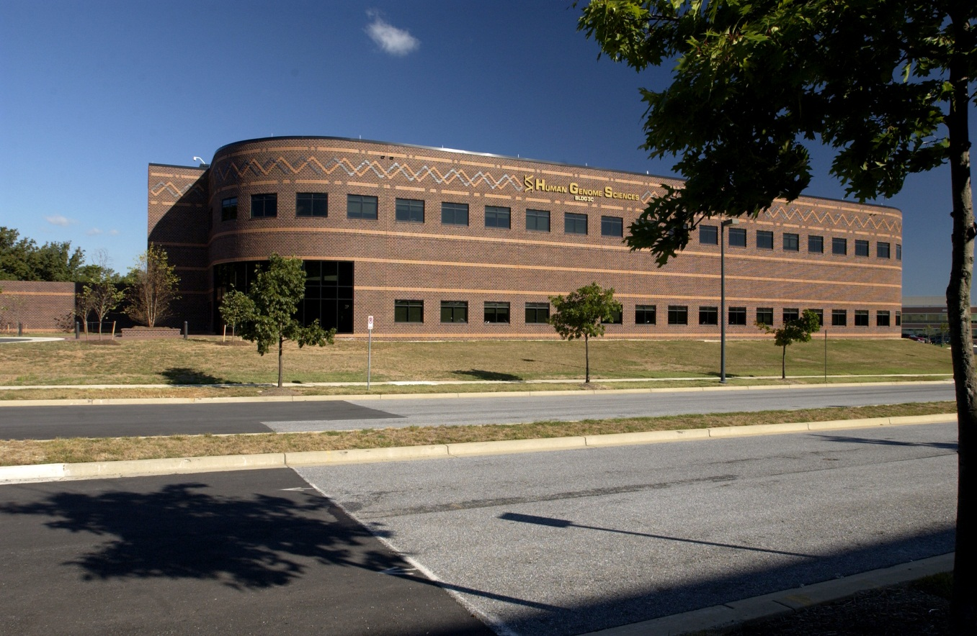
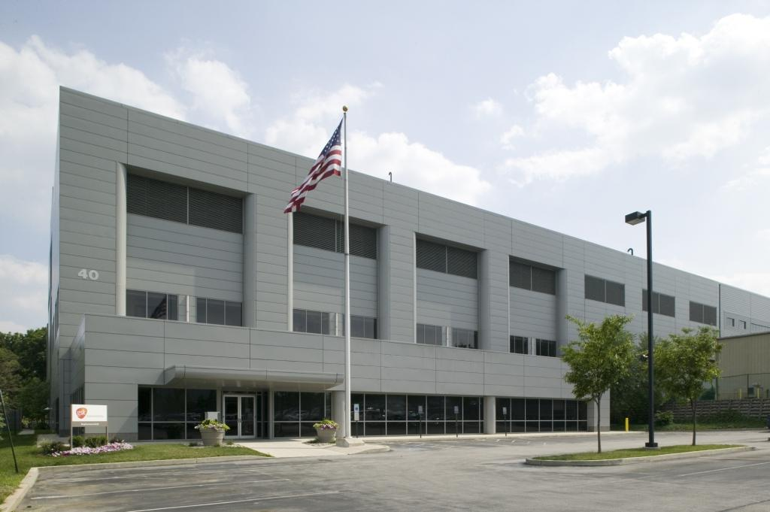
Biopharmaceutical Supply Chain – Contract Manufacturing Capabilities

Slide 2
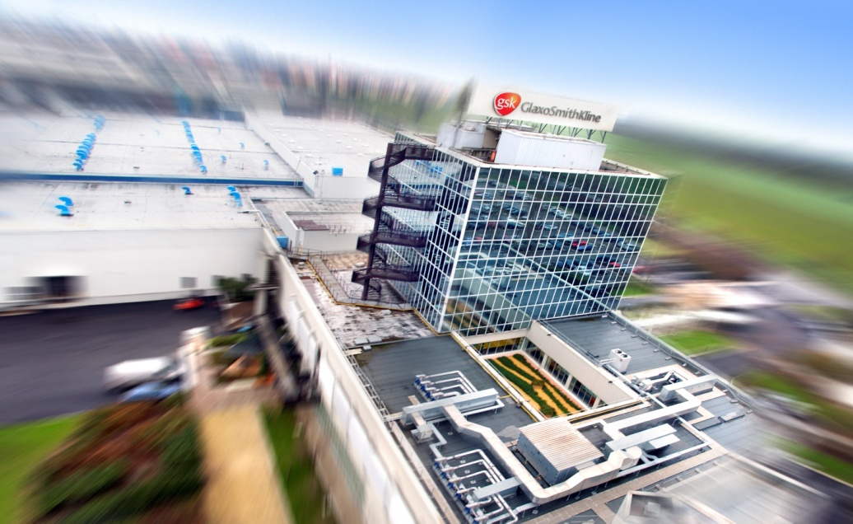
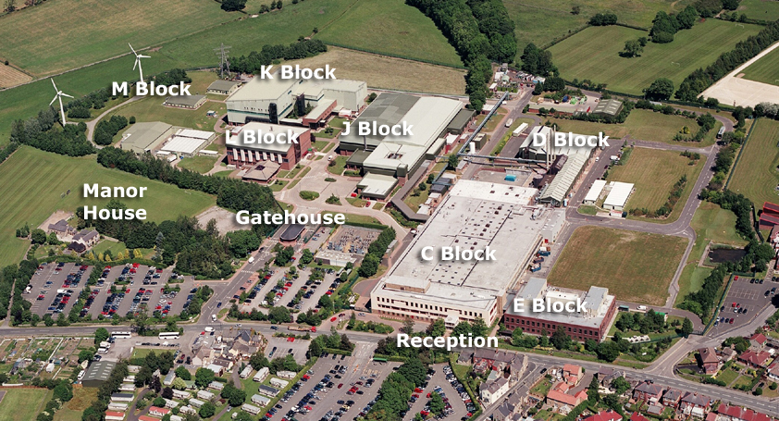
Biopharm Supply Chain – Our Value Proposition
Considerable Experience and Resources
Proven history, facilities, systems, people, and corporate support.
Fully Integrated Supply Chain
Capable of development, manufacturing (drug substance and drug product), testing, and release services from a global network.
Upper Merion
Rockville
Parma
Barnard Castle

Slide 3
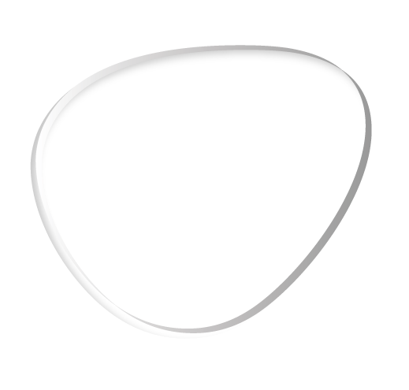
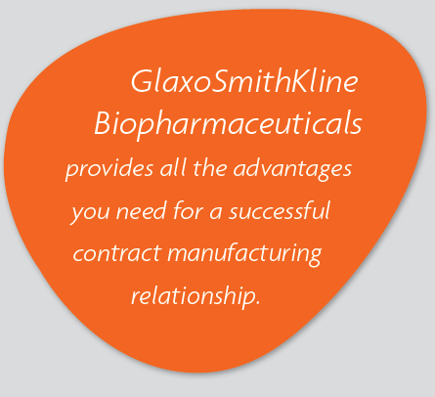
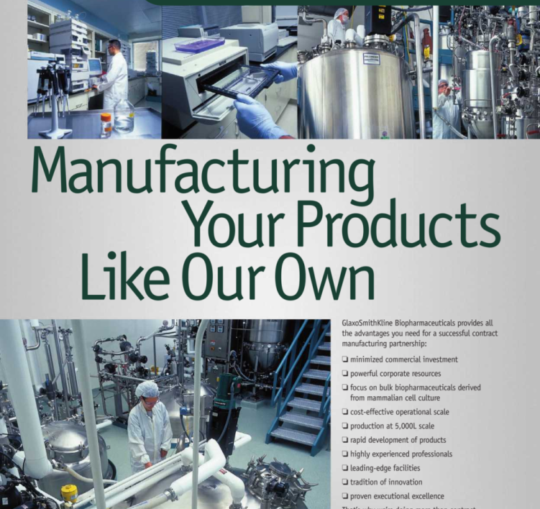
Biopharm Supply Chain – Our Mission Statement
Mission Statement
Be GSK’s manufacturing knowledge centers for enabling launch, supply, and management of biopharmaceutical products around the world.
Business Development
Mission Statement
Leverage these capabilities to provide contract manufacturing services with market leading quality, cost, and time efficiency.

Slide 4
Biopharm Supply Chain – Our Role in GSK
Global Manufacturing and Supply (GMS)
78 sites in 31 countries
Pharma Ops
45 sites in 22 countries
Biopharm Supply Chain
Upper Merion and Rockville
(Drug substance sites with Biopharm capability)
USA
Site based Biopharm Capabilities
Global Supply Chain
Barnard Castle and Parma
(Drug product sites with Biopharm capability)
UK, Italy
Biopharm
Technical Center of Excellence
Global network based Biopharm Capabilities
BioCTL
(Center of Excellence for Testing and Release)
Biopharm External Supply

Slide 5
Upper Merion – Contract Manufacturing Capabilities

Slide 6
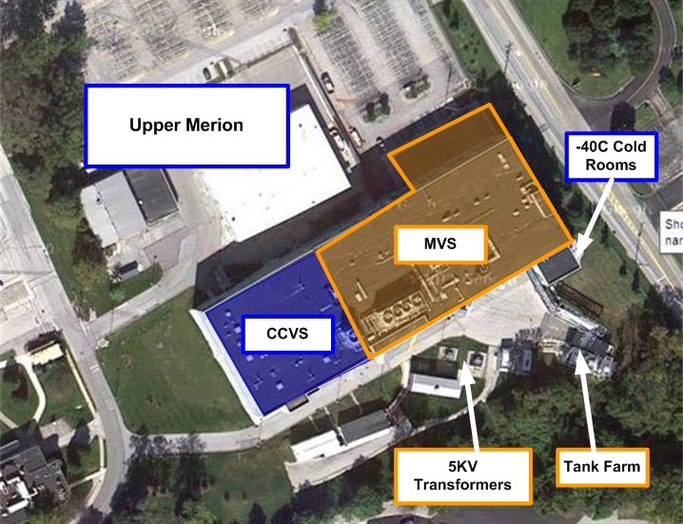
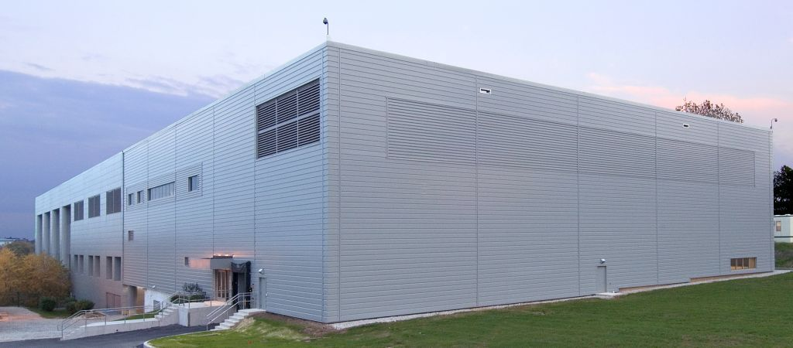
Who are we?
Upper Merion
Located in King of Prussia, a suburb of Philadelphia, PA.
100,000 ft² of production space and 240,000ft² total footprint.
Staffed by approximately 240 people.

Slide 7
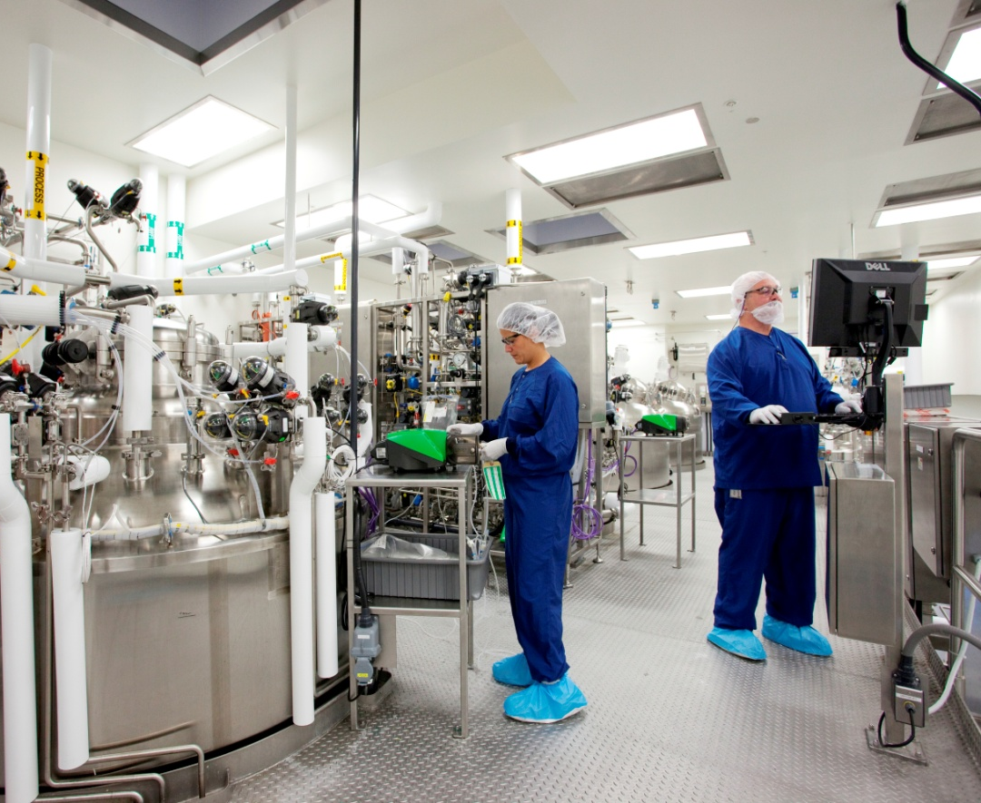
Considerable Experience and Resources – Proven History
10 years experience as a CMO
4 partner firms and 5 products
Multiple Host Organism and Process Platforms
Yeast, CHO, mouse myeloma, insect cell cultures
Batch, fed-batch, multiple harvest, perfusion execution
MVS
CCVS

Slide 8
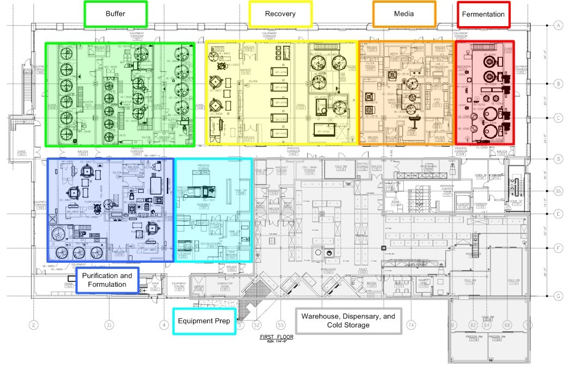
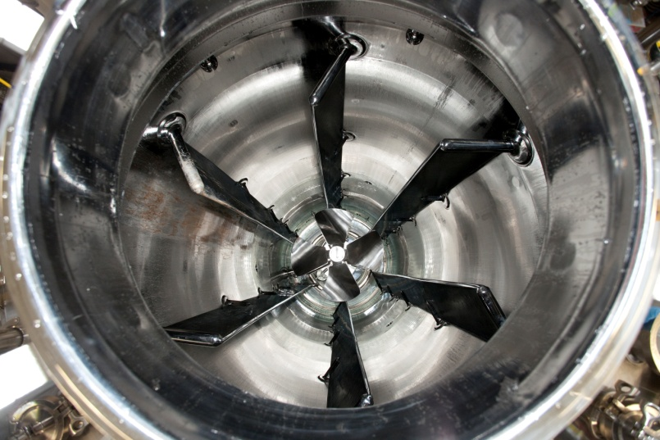
Considerable Experience and Resources – Proven Facilities (Production MVS)
Seed Lab and Seed Train
Shaker flask platform
10:1 scale up ratio
Production Reactors
2 x 10,000L capacity
Fed-batch capable
Harvest
Disk-stack centrifugation
High capacity and flexible depth filtration
Downstream
Flexible operations
5 x 2M columns and ILD, UF/DF

Slide 9
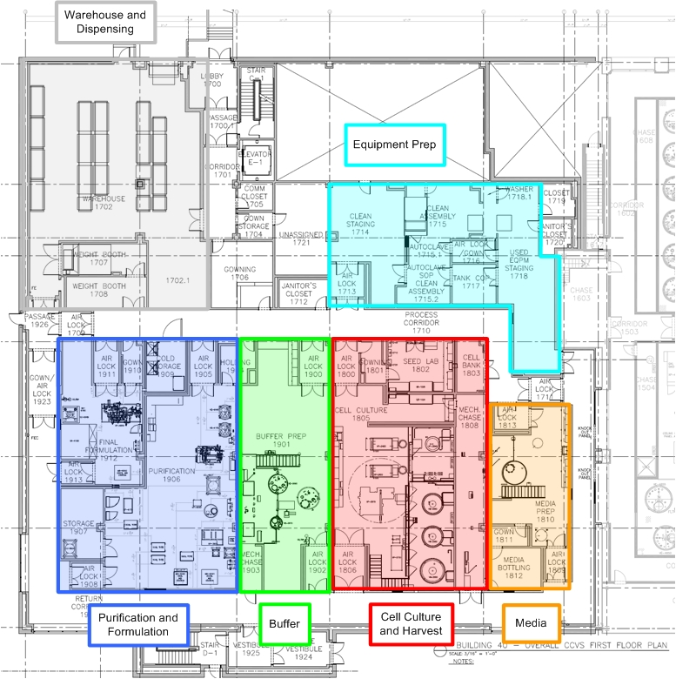
Considerable Experience and Resources – Proven Facilities (Production CCVS)
Seed Lab
Shaker flask & Wave platforms
Seed Train
Disposable and SS options
4:1 scale up ratio
Production Reactors
2 x 5,000L capacity
Fed-batch capable
Harvest
Disk-stack centrifugation
Flexible depth filtration
Downstream
Viral segregation
Flexible operations
VF and UF/DF
Capable of columns up to 1M

Slide 10
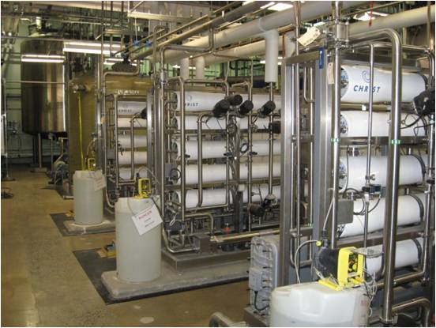
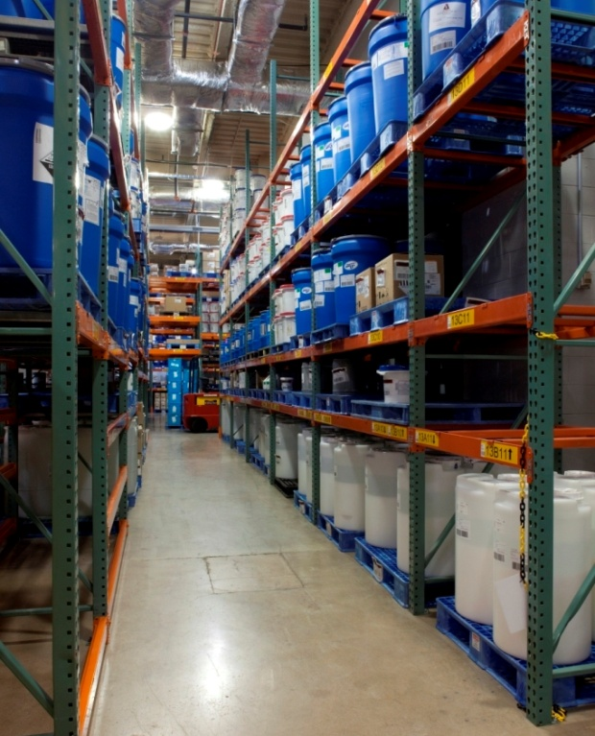
Considerable Experience and Resources – Proven Facilities (Utilities and Infrastructure)
Plant and Clean Utilities
N+1 redundant and VS segregated
200,000 GPD pure water capacity
Waste inactivation and collection capacity
Control and IT Systems
VS segregated DeltaV systems (7,500 IO)
PLC and BAS for utilities (1,500 IO)
HVAC
28 segregated AHUs
Classification from ISO5 to CNC
Warehousing
VS segregated 600 pallet spaces
Cold storage capacity (-40C and -70C)

Slide 11
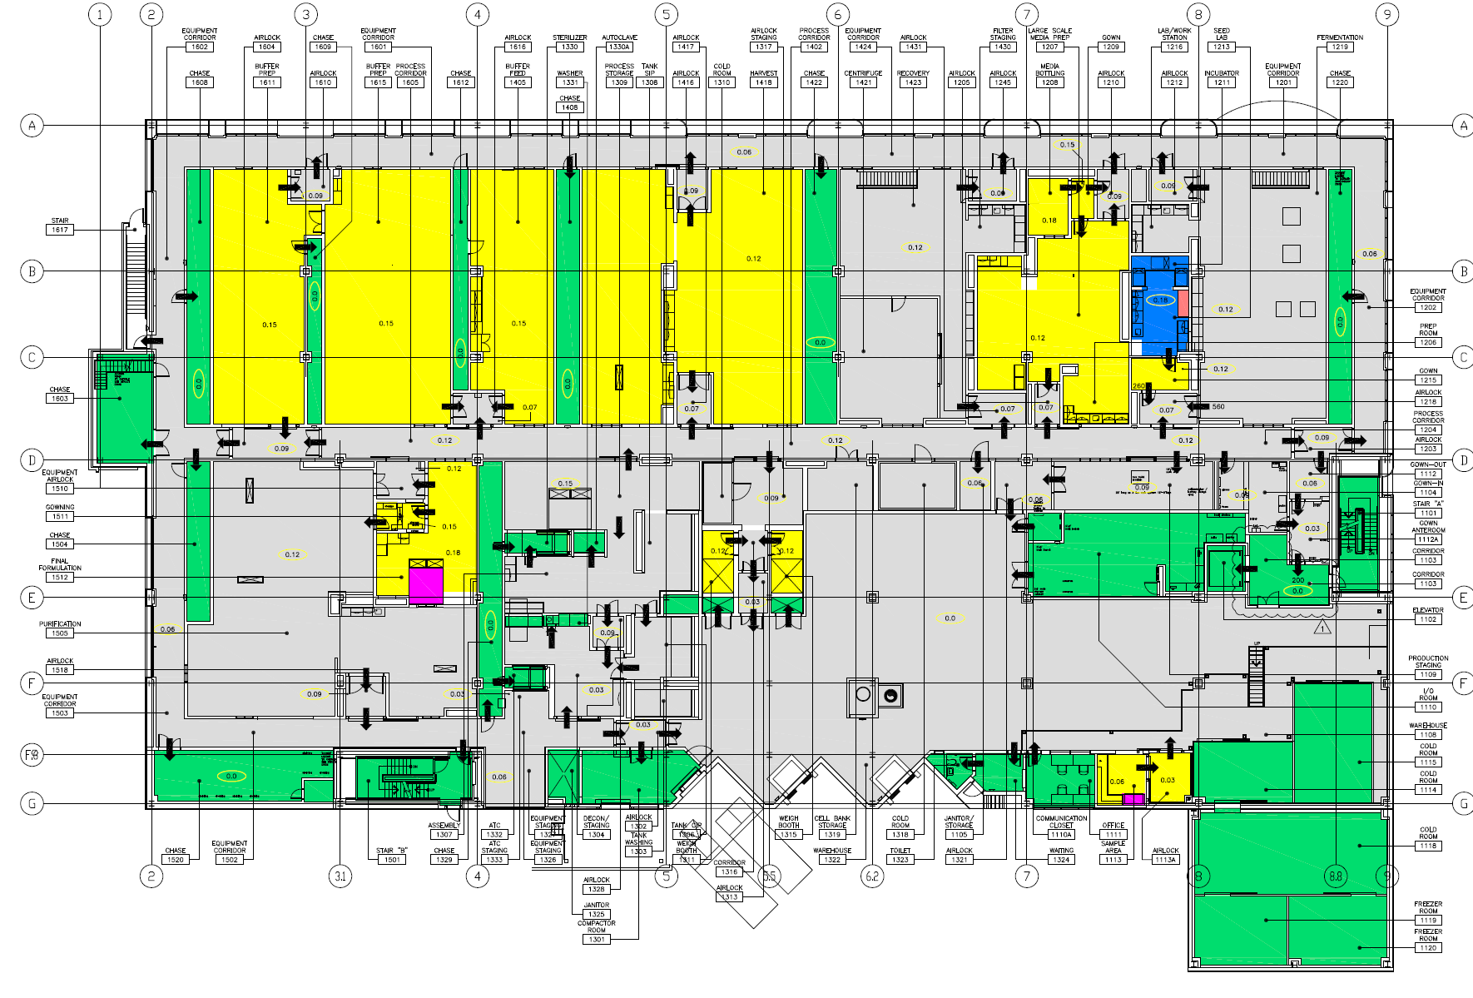
Considerable Experience and Resources – Proven Procedures (Changeover and Segregation)
Suite Segregation
Physically separated buildings
Shared utility generation, segregated utility distribution
Campaign Dedicated Equipment
Demonstrated change over procedures
Quality oversight and clearance procedures
HVAC Design
Open live processing within bio safety cabinets
Room air pressurization and cascades
SAP
Separate BOM’s for each product
Flows and Controls
Personnel, equipment, material, and waste flows
Qualified disinfectants and EM control

Slide 12
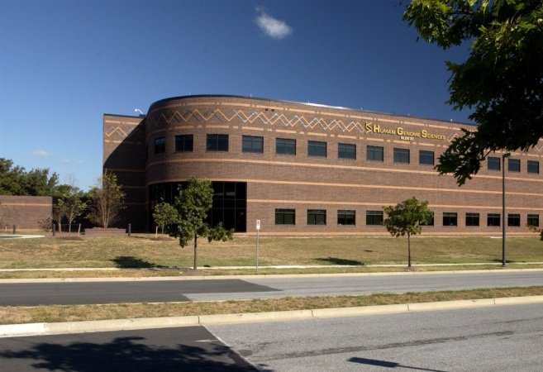
Rockville – Contract Manufacturing Capabilities

Slide 13
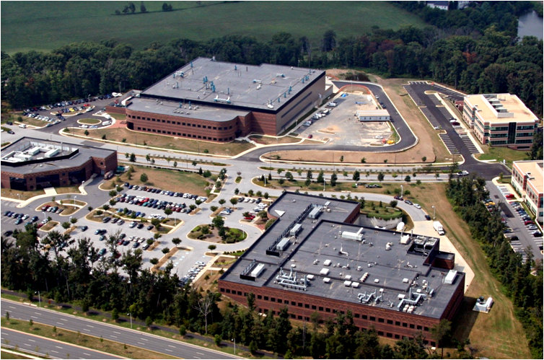
Who are we?
Rockville
Located in the suburbs of Baltimore, MD and Washington, DC.
LSM: 80,000 ft² of production space and 290,000ft² total footprint.
SSM: 130,000 ft² total footprint.

Slide 14
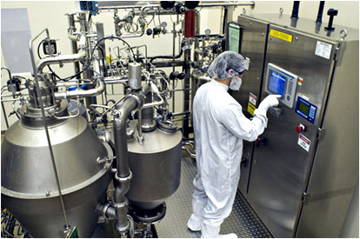
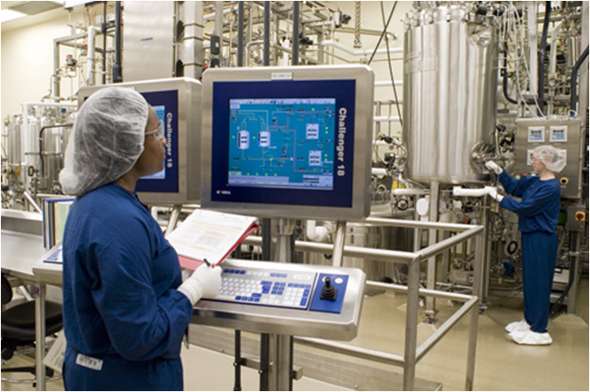
Considerable Experience and Resources – Proven History
6 years experience as a CMO
5 partner firms and 6 products
Multiple Host Organisms and Scale Flexibility
Yeast and CHO cultures
Cell culture capability from 1,600L to 20,000L.
Contract Development Services
Full upstream and downstream drug substance capability to 400L.
Full drug product capability including freezer dry to 10,000 vials.

Slide 15
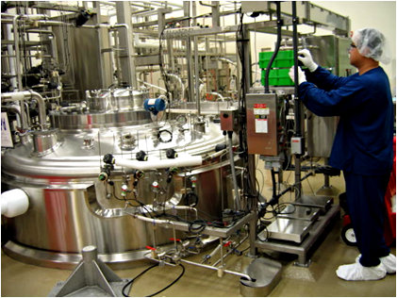
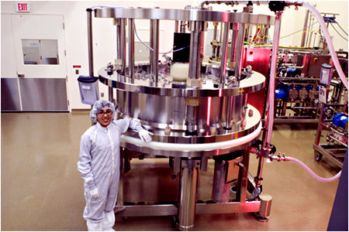
Considerable Experience and Resources – Proven Facilities (LSM)
Seed Lab and Seed Train
2 x 50L, 1 x 500L skids
Production Reactors
Media pasteurizer
1 x 5,000L Seed or Production Reactor
2 x 20,000L capacity
Fed-batch capable
Harvest
2 x Disk-stack centrifuges
2 x Depth filtration skids
1 x 1M column, Gradient Capability
Downstream
Flexible operations
3 x 1.6M columns, Gradient Capability
VF and UF/DF
2 x IBI Controlled Rate Freezing Systems

Slide 16
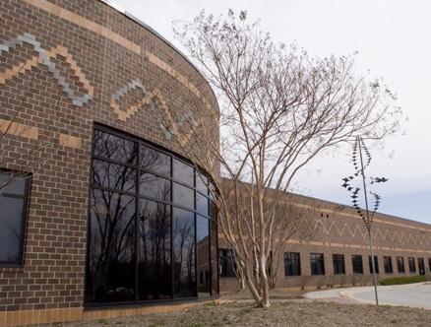
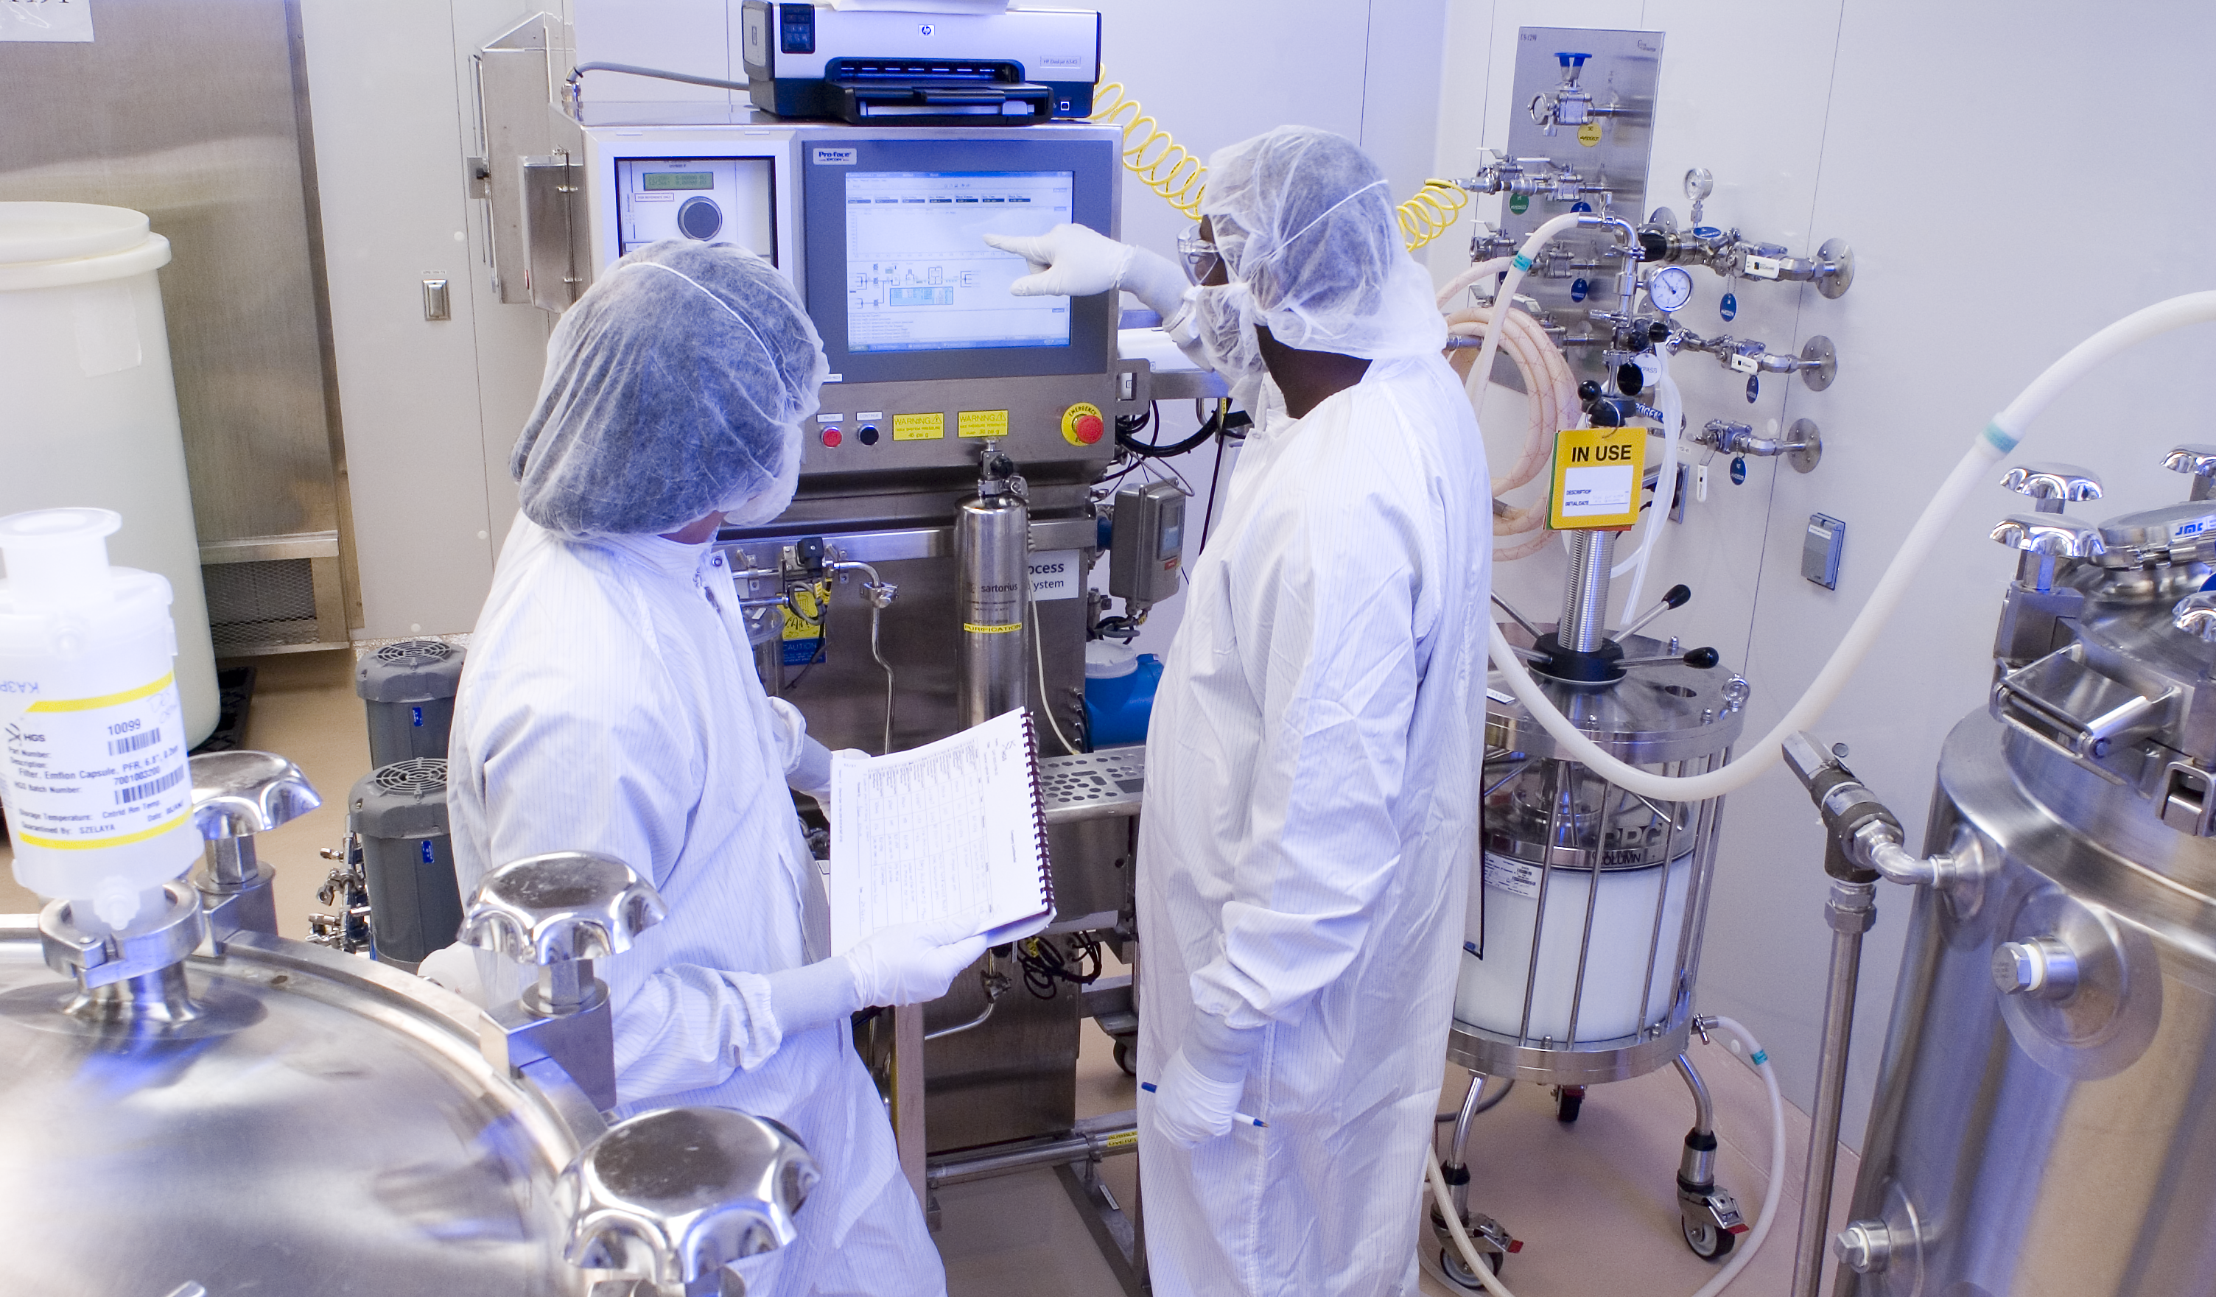
Considerable Experience and Resources – Proven Facilities (SSM)
SSM Mammalian
Upstream
1 x 25L, 2 x 200L seed train kids
2 x 1,600L production capacity
Downstream
Disk-stack centrifuge
Depth filtration skids
2 x 45cm, 1 x 30cm columns
VF and UF/DF
SSM Microbial
Upstream
150L seed train
1 x 650L production capacity
Downstream
Disk-stack centrifuge
Depth and micro filtration skids
3 x 30 – 35cm columns
UF/DF

Slide 17
GMS Biopharmaceuticals – Drug Product Capabilities

Slide 18
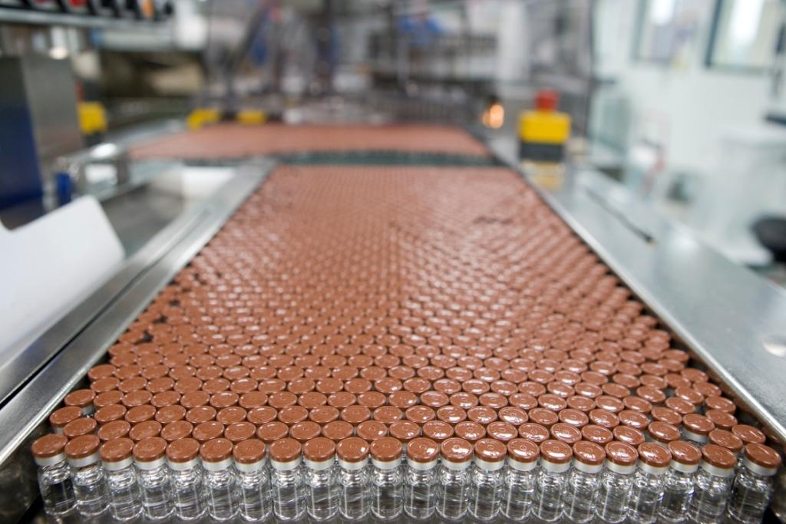
Fully Integrated Supply Chain – Drug Product Capabilities
Liquids & Freeze Dry Products
Facilities in Parma, Italy and Barnard Castle, UK.
Support large GSK and contract product base.
Contract clinical and commercial capacity.
Recognized world-class sites in quality, technology, and controls.
Multiple formats (vials, syringes) and dose ranges (0.5ml – 100ml).
Large lyophilization and overall capacity.

Slide 19
GMS Biopharmaceuticals – Development / TT / Quality / Analytical Capabilities

Slide 20
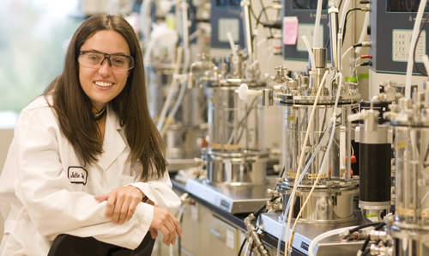
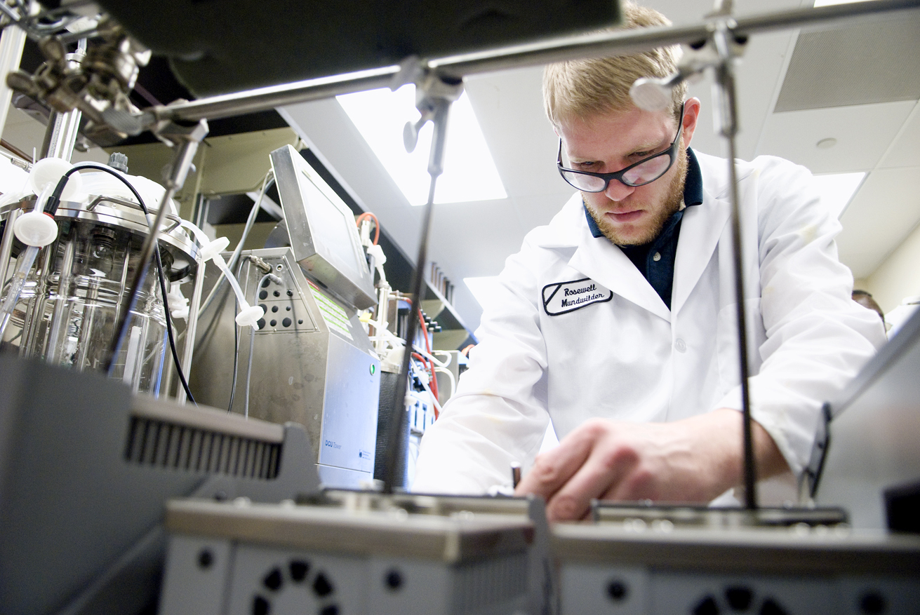
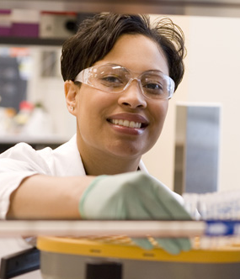
Considerable Experience and Resources – Development Capabilities
Drug Substance
Cell line development and banking
Process characterization utilizing design space mapping via DOE
Viral clearance studies and toxocology lot manufacture
Equipment (Bioreactors, fermentors, chromatography) capabilities to 400L
Drug Product
Capability to develop and characterize liquid and lyophilized formulations
Characterization with sub-visible particle and forced degradation studies
Reference fills up to 7,000 vials and toxicology fills up to 10,000 vials

Slide 21
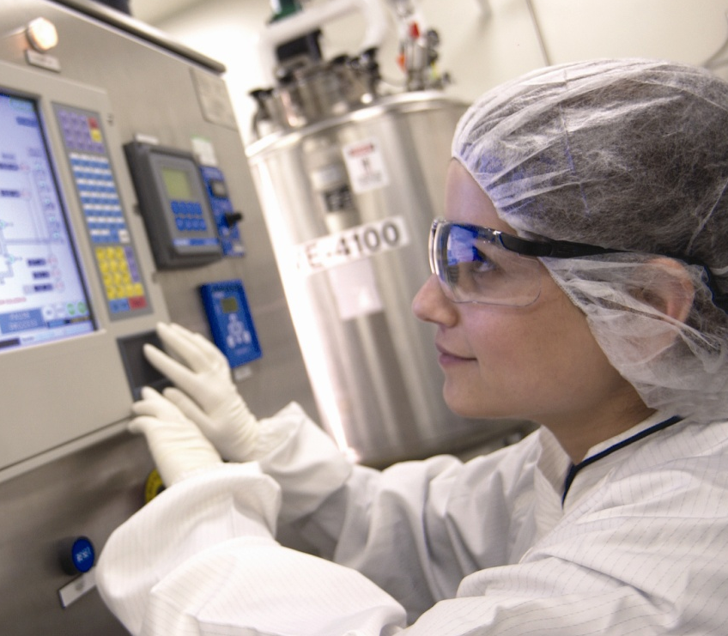
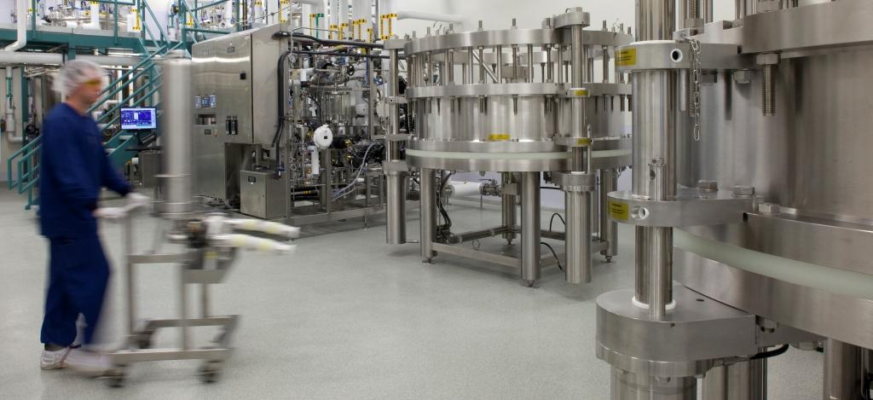
Considerable Experience and Resources – Proven People with TT Experience
Tech Transfer and PM
Dedicated PM and single client POC
Dedicated new production introduction and technology departments
First intent internal engineering, automation, validation
Flexible, Capable Workforce
Not VS dedicated, target BS in engineering
Low turnover (<10%) and high retention (> 5 year average)
Focus on RFT with a culture of continuous improvement

Slide 22
Proven Quality Systems – Inspection History
SSM
4 total FDA inspections
2 PAI inspections
1 license approvals
Multiple client audits / year
LSM
1 FDA biennial inspection, 1 PAI inspection
1 EMEA inspection
1 Health Canada
Multiple license approvals (EU, Canada, South Korea)
6 ROW inspections
Multiple client audits / year
Upper Merion
4 total FDA inspections
2 PAI inspections
2 license approvals
Multiple client audits / year

Slide 23
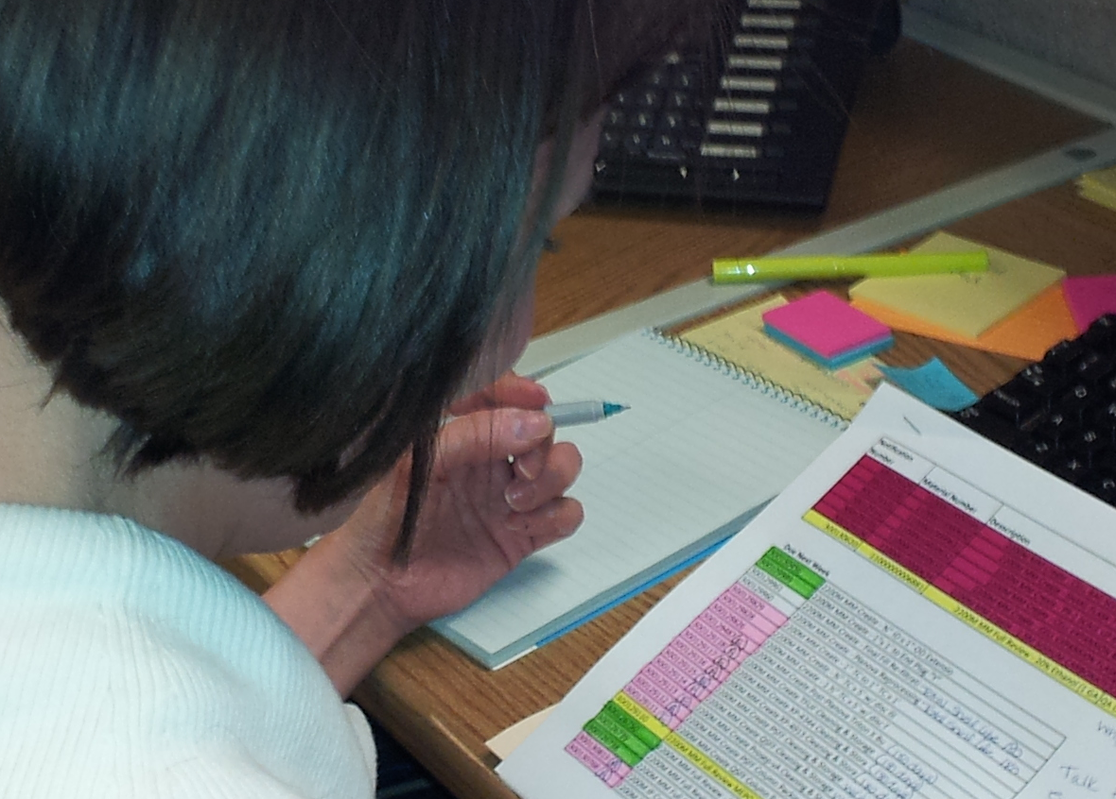
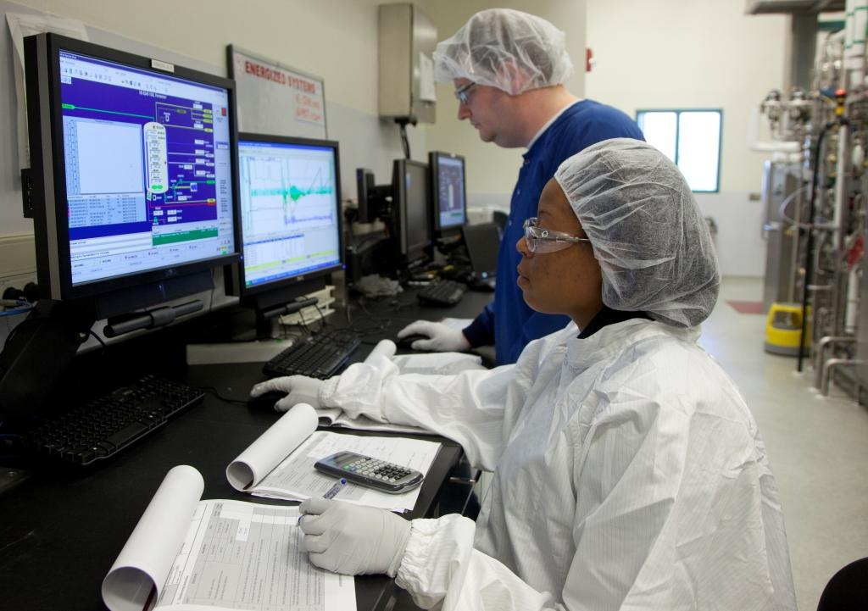
Proven Quality Systems – Responsibilities and Resources
Full Functionality at Site
Quality Agreement preparation
Custom Certification Program
Integrated Floor Quality Assurance
Level 1 & 2 audit
Raw material testing and control
Deviation management
CAPA management
Change control management
Batch release
Training management
Facility and equipment validation
Regulatory Compliance function
Global Corporate Resources
Global QMS (US, EU, ROW standards)
Corporate audit support
Technical support (Biopharm CoE)
IT System support (SAP, Trackwise, Documentum)

Slide 24
Proven Quality Systems – Focus and IT Tools
Systematic Approach
Efficient Operations
Metrics
Continuous Improvement
QLIMS – Laboratory data management
TrackWise – Exceptions, change controls, deviations
QUMAS, CDMS – Controlled document management
Plateau – Training program administration
EAMS – Calibration and preventive maintenance
AEGIS – Process data management
SAP – Resource planning, environmental monitoring, asset and inventory management
IT Systems Used as Process Enablers

Slide 25
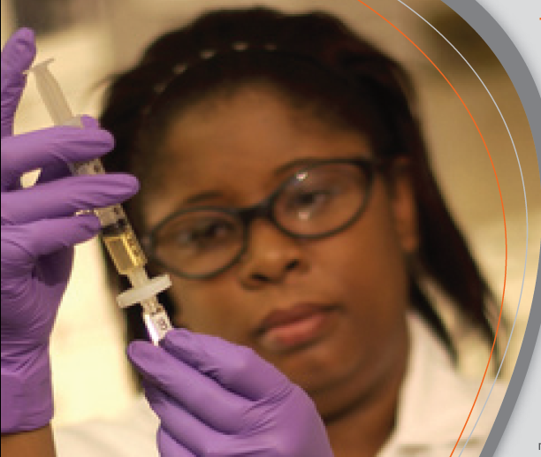
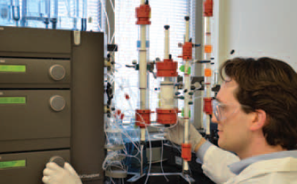
Fully Integrated Supply Chain – Analytical Capabilities
In-House Laboratories
Raw material testing
In-process and release QC testing and small scale process support
Biochemical analysis / characterization, microbiological methods
ELISA ID
Bioassay
RP-HPLC
UPLC
SEC
cIEF
SDS Page
qPCR
HCP ELISA
Residuals
Bioburden
Endotoxin
Assay development, tech transfer, validation, qualification

Slide 26
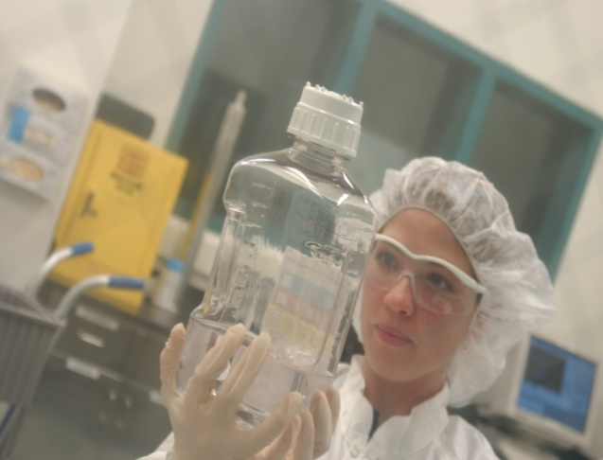
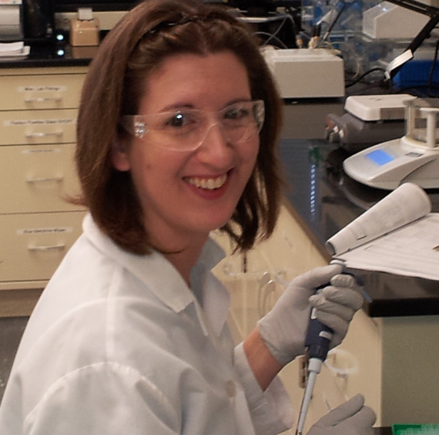
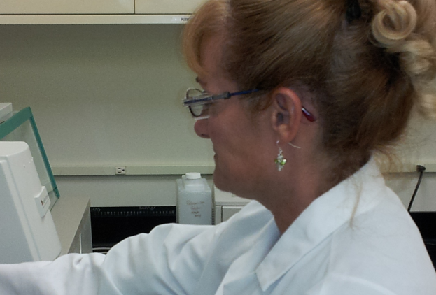
Fully Integrated Supply Chain – Analytical Capabilities
Bio-CTL (Biopharm CoE for Testing and Release)
Located in EU
DS and DP testing, batch release, stability testing
Critical reagent control and testing
Master, working, analytical cell bank storage

Slide 27
Biopharmaceutical Contact Manufacturing
www.gsk.com/biopharm

